Slide 1
CSE 216 E-commerce site
Prepared By: Farhan Tanvir Utshaw (1505105)
Masfiqur Rahaman (1505111)
Project Supervisor: Abida Sanjana
Lecturer, Department of CSE,
BUET

Slide 2
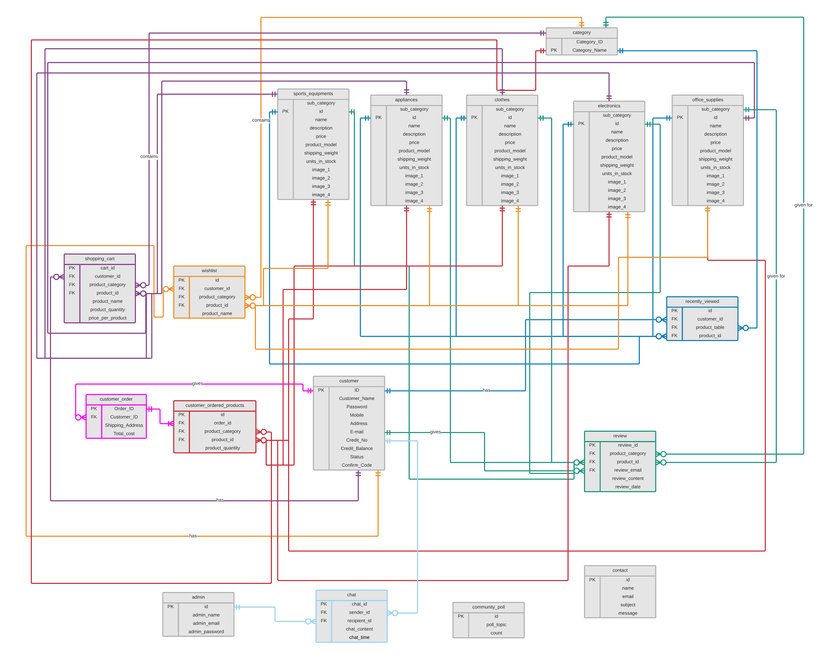
ED Diagram – Full Page

Slide 3

Place your screenshot here

Slide 4
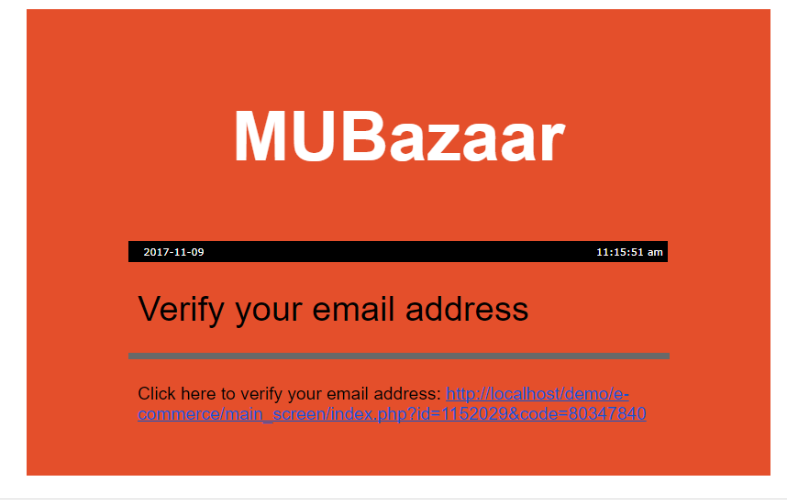
Verification of Email on Sign Up

Slide 5
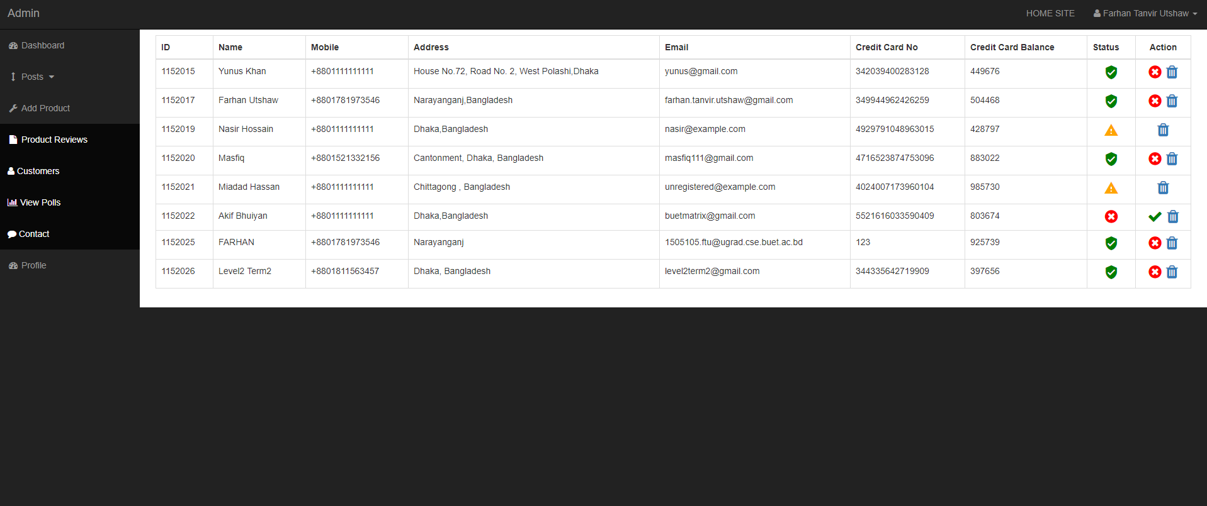
Admin can block, unblock, delete customers

Slide 6
THANKS!

